Slide 1
Dress Down Day
Friday, October 30, 2015
$2 to Participate

Slide 2
What Can You Wear?
Black or Orange Themed Dress Down Day Outfit
A School APPROPRIATE Costume

Slide 3
Basic Dress Down Day Rules

Slide 4
No Weapons, Spikes or Anything that Can Harm Another Student
This includes, but is not limited to:

Slide 5
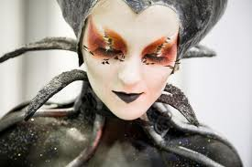
No Full Face Make Up or Masks
These are NOT permitted:
These are PERMITTED:
If we cannot tell who you are, it is not permitted.

Slide 6
No Revealing Clothing
This costume is okay:
If you have a question about your costume, it may not be appropriate
Ask your advisory teacher or Mr. Walsh

Slide 7
Not permitted:
Leggings/Spandex
Skirts (UNLESS it Falls at the Knees)
Low Cut Tops
Midriff Tops
Tank Tops (Unless Covered)

Slide 8
No Costumes that hinders a student from doing school based activities.
Costumes should not be restrictive
Students should be able to walk in hallways and use stairs without issues
Costumes should not hinder/stop other students from moving through hallways.

Slide 9
Still Have Questions??
Check the Cadet Handbook
Ask your homeroom teacher
Have your homeroom teacher contact Ms. Fanega, Mrs. Huebner, or Mr. Walsh if your question is still not being answered.

Slide 10
Don’t Forget about Our Trunk or Treat!
$5 for cars who participate
FREE for cadets who are in costume
Takes place from 5:30 PM to 7:30 PM in the East Parking Lot

